Slide 1
PyCon India-2016
Interactive Date Plotting With Bokeh
Kaustuv Deolal

Slide 2
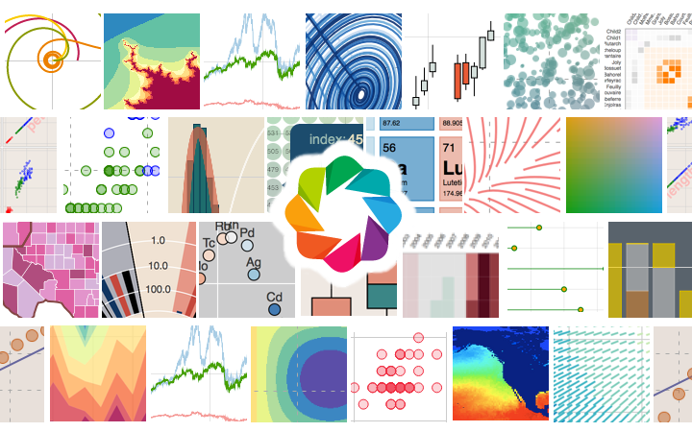
Bokeh !! Well what is that ?

Slide 3

The Question is Unanswered!
Well he would say
Bokeh is a Python interactive visualization library that targets modern web browsers for presentation. Its goal is to provide elegant, concise construction of novel graphics in the style of D3.js, and to extend this capability with high-performance interactivity over very large or streaming datasets. Bokeh can help anyone who would like to quickly and easily create interactive plots, dashboards, and data applications.

Slide 4

On the contrary ?
In Rancho’s words !
“A pretty amazing plotting library with tons of features”

Slide 5
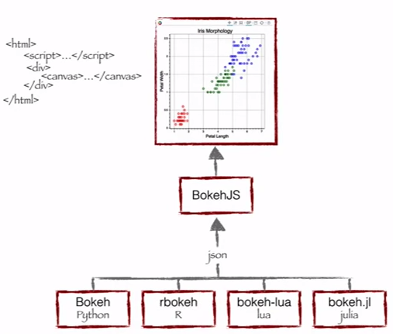
How does Bokeh works??
Bokeh is simply not confined to Python. It has bindings in different languages. These languages output a Json file which serves as an input for BokehJS , which is a JavaScript library
Since this is PyCon we will be talking about Bokeh Python only !!

Slide 6
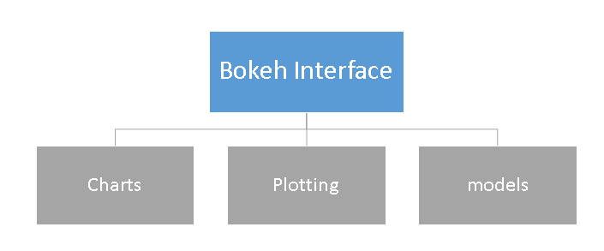
What does Bokeh Offer?

Slide 7
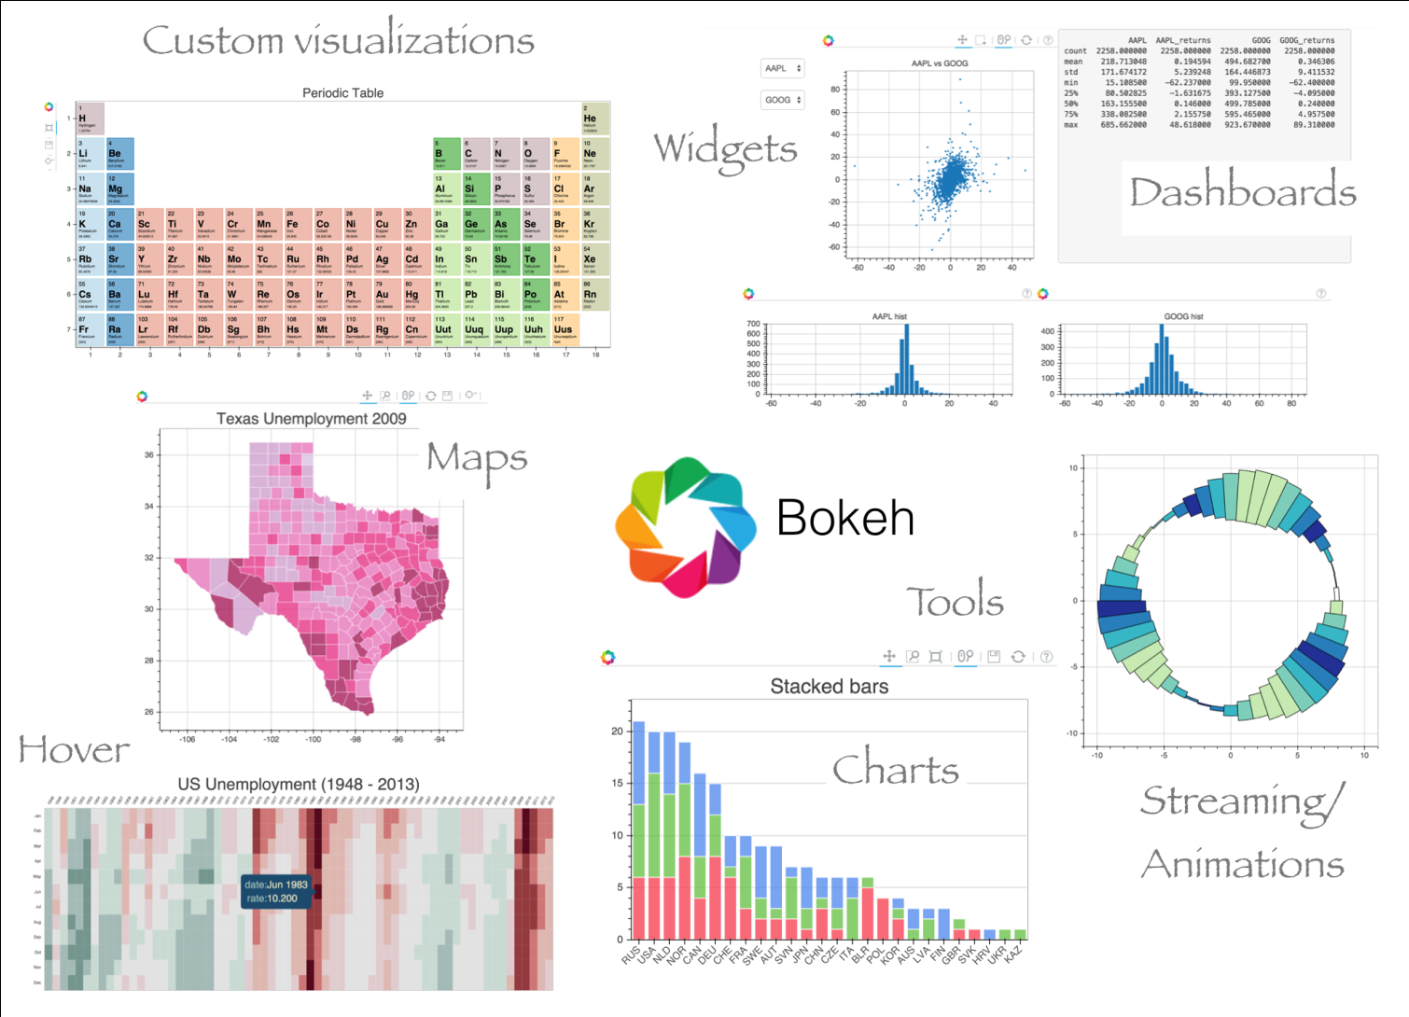
A better picture !

Slide 8
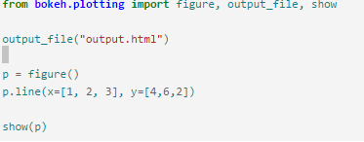
Key Features
Output features
File Notebook Server .Here we show only file

Slide 9
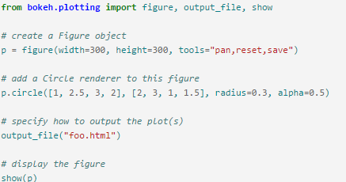
Plotting with Bokeh

Slide 10
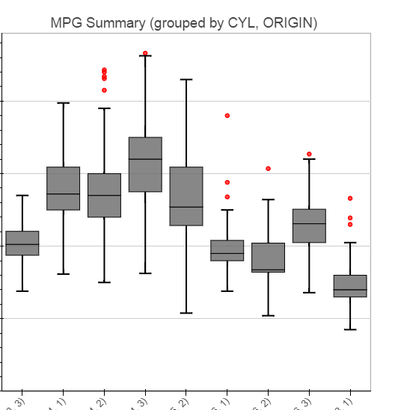
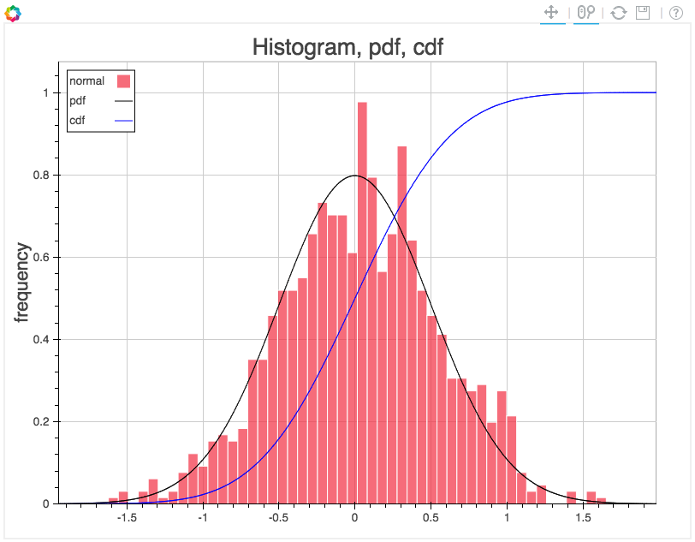
Charts !!

Slide 11
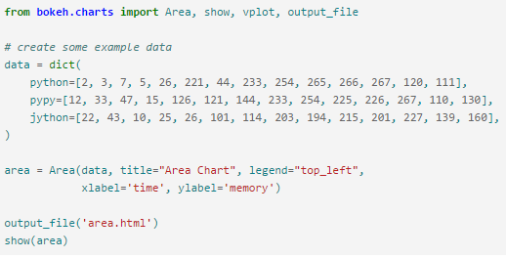
Basic Charts Code

Slide 12
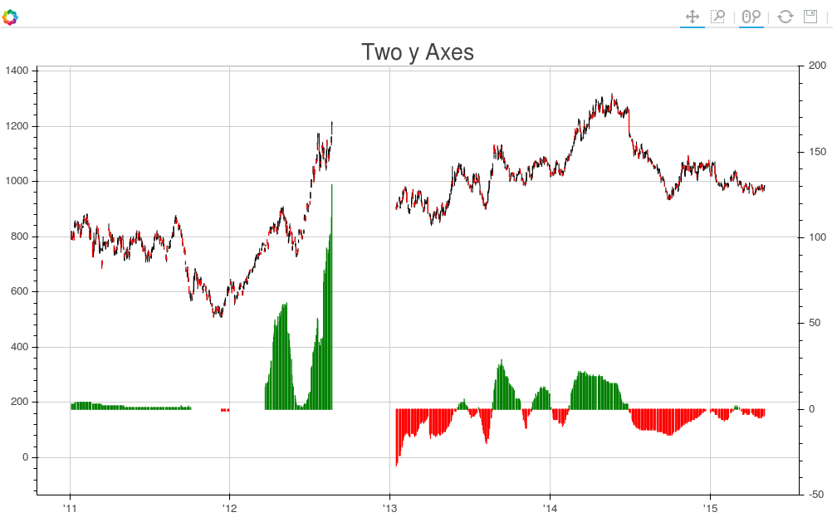
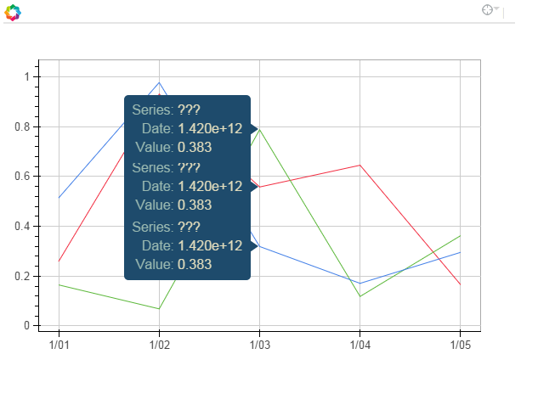
Charts Continued……

Slide 13
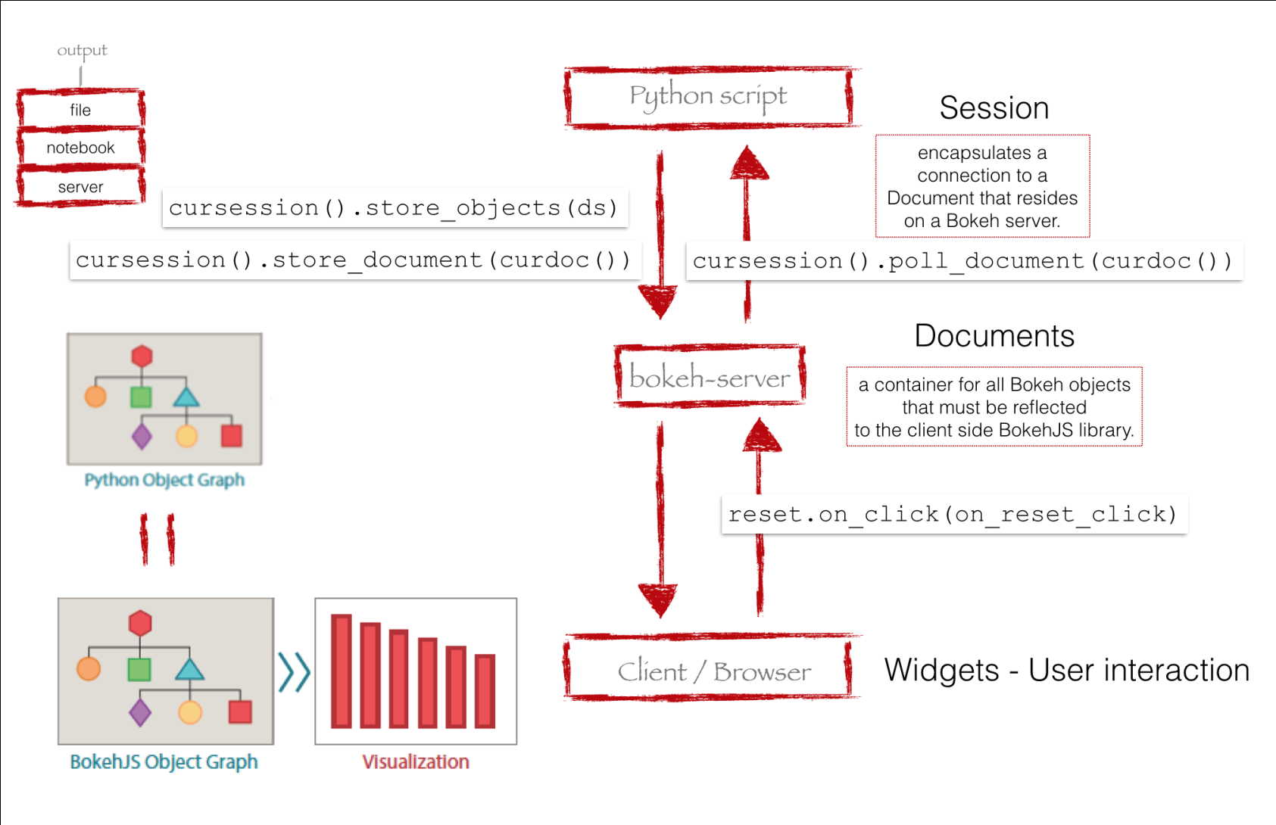
It is not all ??? Bokeh Server make interaction Dynamic

Slide 14
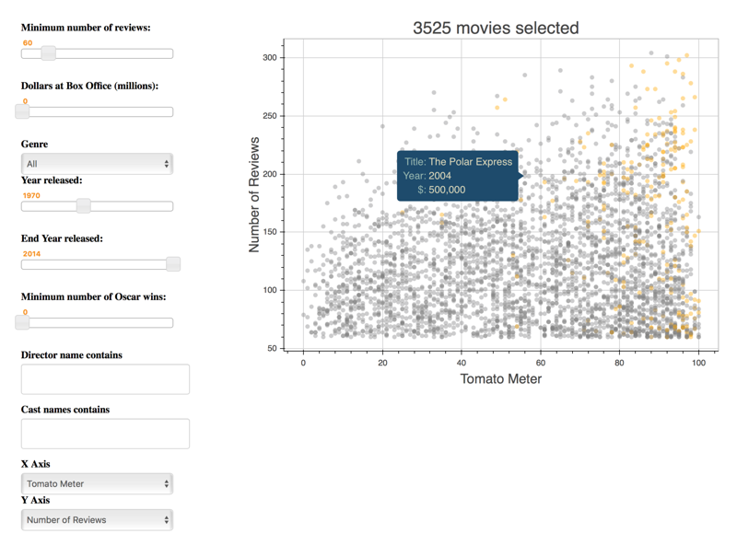
A movie server !!

Slide 15
Using a custom flask server !!
Yes Flask can be integrated with Bokeh
It does make altogether more dynamic
If you have an external web service that you can communicate with to control your data and your app behaviour then you can actually achieve very powerful functionalities

Slide 16
THANK YOU !!

